Slide 1
FMP INITIAL PROPOSAL (8.1.1)

Slide 2
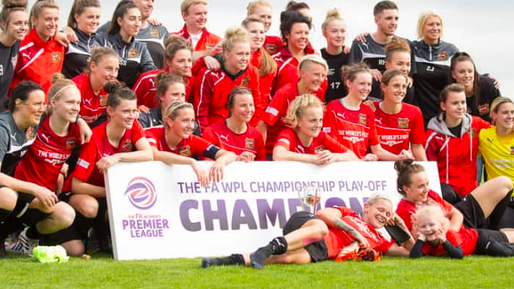
a) Theme:
The Theme of my FMP will be Sport. More specifically the Sheffield FC Woman's team and the growth of woman's football
b) Target audience:
My target audience will be of any age upwards of around 15. Their interest will be sport and probably football. The majority of my target audience would probably be woman.

Slide 3
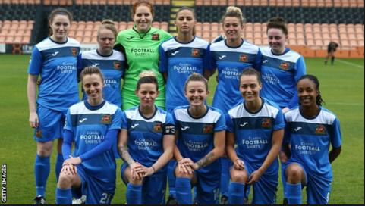
Why woman's football?
- Women’s football has evolved massively in the UK and around the world, especially over the last few years; and the figures back that up.
- Growing attendance figures, ground-breaking broadcasting deals and a more equal society have raised awareness at the top end of the sport, and participation amongst grassroots teams.

Slide 4
Content ideas:
- A good infographic Idea would be to show the rise in participation and the rise of people watching woman's football over the last few years.
infographic
- One idea for a news story would be about the growth of woman's football in Sheffield and the UK. I could get interviews for the feature from Sheffield FC
Content Ideas
Podcast
News story
- Reach out to Sheffield FC to see if I could interview a player or member of staff for a podcast
V
i
d
e
o
Film a video on how the Sheffield Fc woman's team is doing this season and how it compares to previous seasons, I could use highlights of matches and interviews for it.

