Slide 1
Publication
To publish is to make content available to the general public. While specific use of the term may vary among countries, it is usually applied to text, images, or other audio-visual content, including paper. The word publication means the act of publishing, and also refers to any printed copies.

Slide 2
How many people read the Yorkshire post monthly?

Slide 3
All the types of News values.
There are many news values 9 in total,
Conflict
Surprise
Good News
Bad News
News Agenda
Magnitude
Power Of Elite
Celebrity
Follow Up

Slide 4
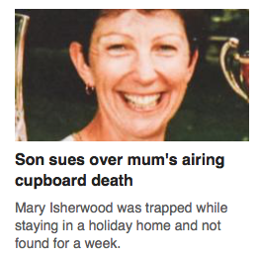
Human interest and scandal link to this topic.

Slide 5
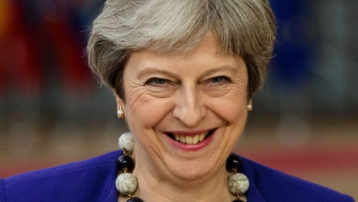
Negativity, reference to elite persons, continuity, frequency predictability

Slide 6

Refernce to elite nations, predictability and visual imperative

Slide 7
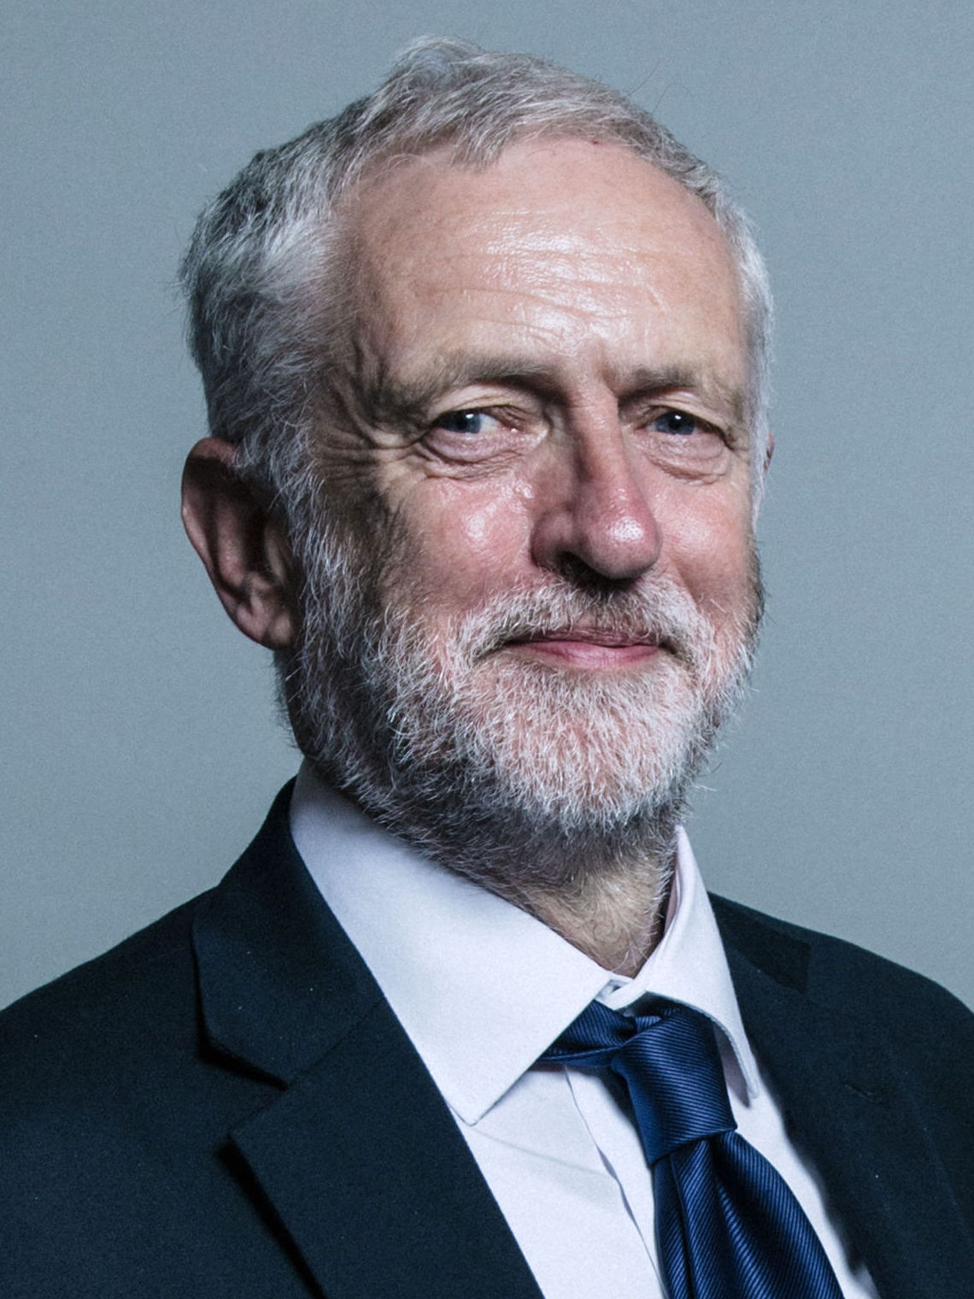
Continuity, elite persons

