Slide 1

News Values
LO: to understand how to apply news values terms
Keywords / Key theories:
Galtung & Ruge’s (1965) 14 News Values
Gatekeeping
Agenda setting
News agenda
Harcup & O’Neill (2001) News Values
Newsworthy
Do It Now
On your post-it, write down at least three things that you value.

Slide 2
Typical things we value
Family
Health, fitness, wellbeing
Having money
Food and drink
Knowledge
Politics
Beliefs
Relationships (popularity, fitting in, marriage, girlfriend/boyfriend, friendships, connection)
Hobbies (favourite football team, music, films, entertainment)
Concepts - Happiness, Freedom, Peace, Love, Justice, Hope, Equality

Slide 3


What is a ‘value’?
The importance, worth or usefulness of something.
Principles or standards of behaviour.
A judgement of what is important in life.

Slide 4
What is a News Value?
A news value is a characteristic that a story has that makes it newsworthy –
something about the story that makes it important and worthy of being printed or broadcast.

Slide 5
Galtung and Ruge (1965) – News Values
These two media theorists researched the news output of several news media organisations around the world.
They came up with a list of characteristics of stories that editors think of as being important.
They called these characteristics ‘news values’.
So, when deciding whether a story is newsworthy, the editor would think about whether the story has enough news value.

Slide 6
The type of stories that the news media value
Analyse the content of an example of news media and
write down what you think the news media value
Business
Politics (power)
Law
Banking (money)
Economics
Scandal
Defence (war)
Education
NHS
Tax
Human Interest
Housing
Environment
Employment
Welfare
Transport
Insurance
Culture
Sport
Celebrities
Scandal
Gossip
Photographs

Slide 7
Galtung & Ruge (1965) – News Values
Threshold
Frequency
Predictability
Unambiguity
Visual imperative
Proximity
Continuity
Reference to elite nations
Unexpectedness
Personalisation
Reference to elite persons
Composition
Negativity

Slide 8

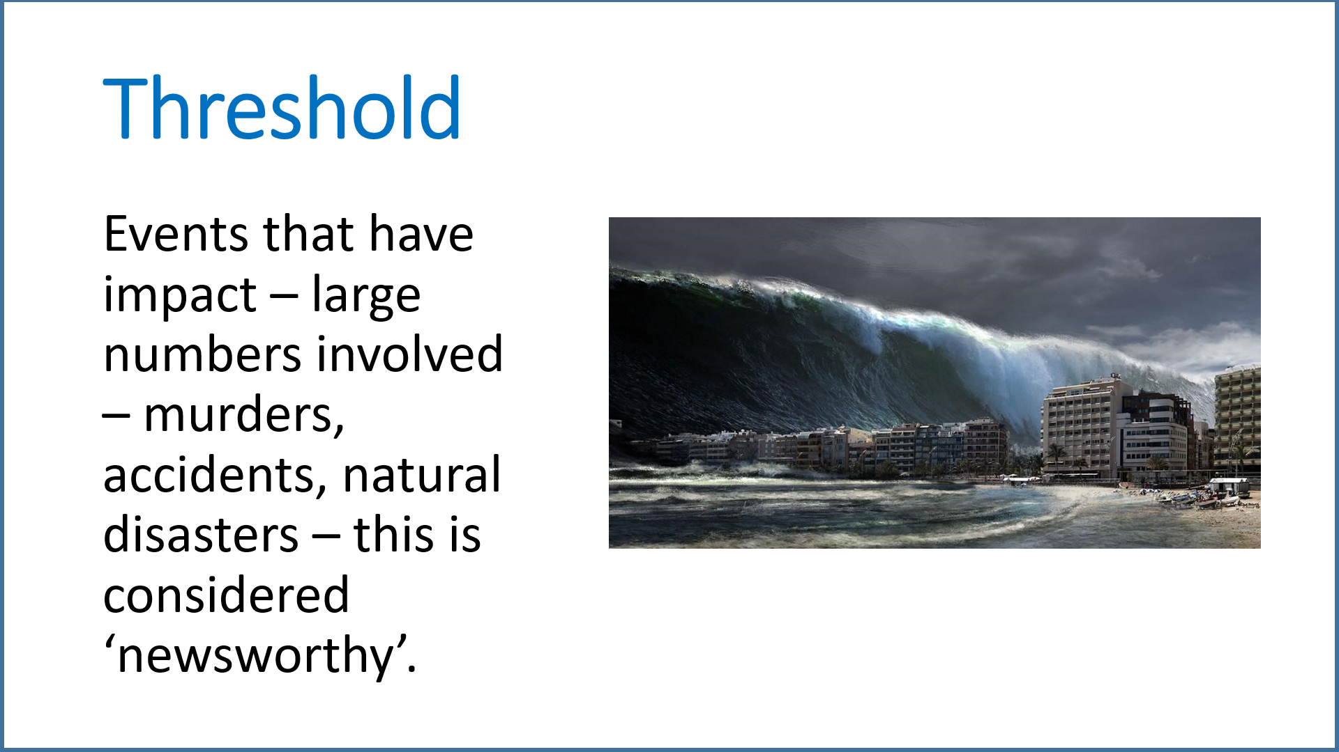
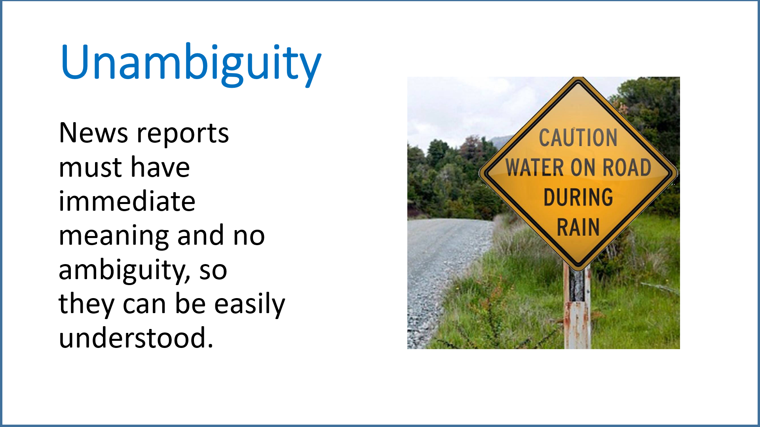


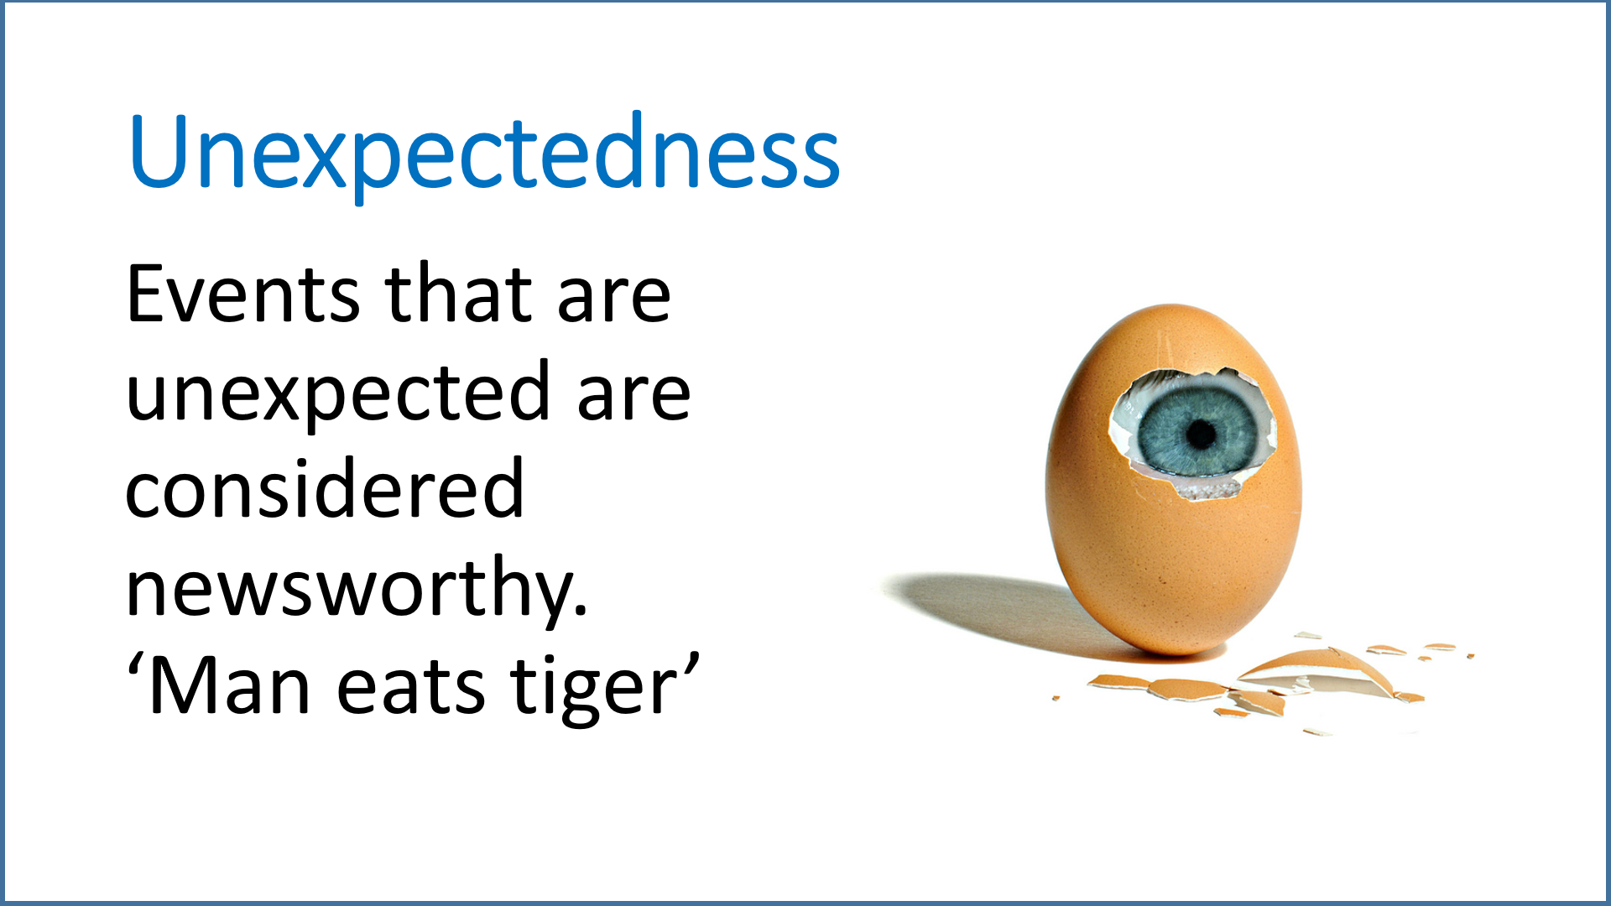
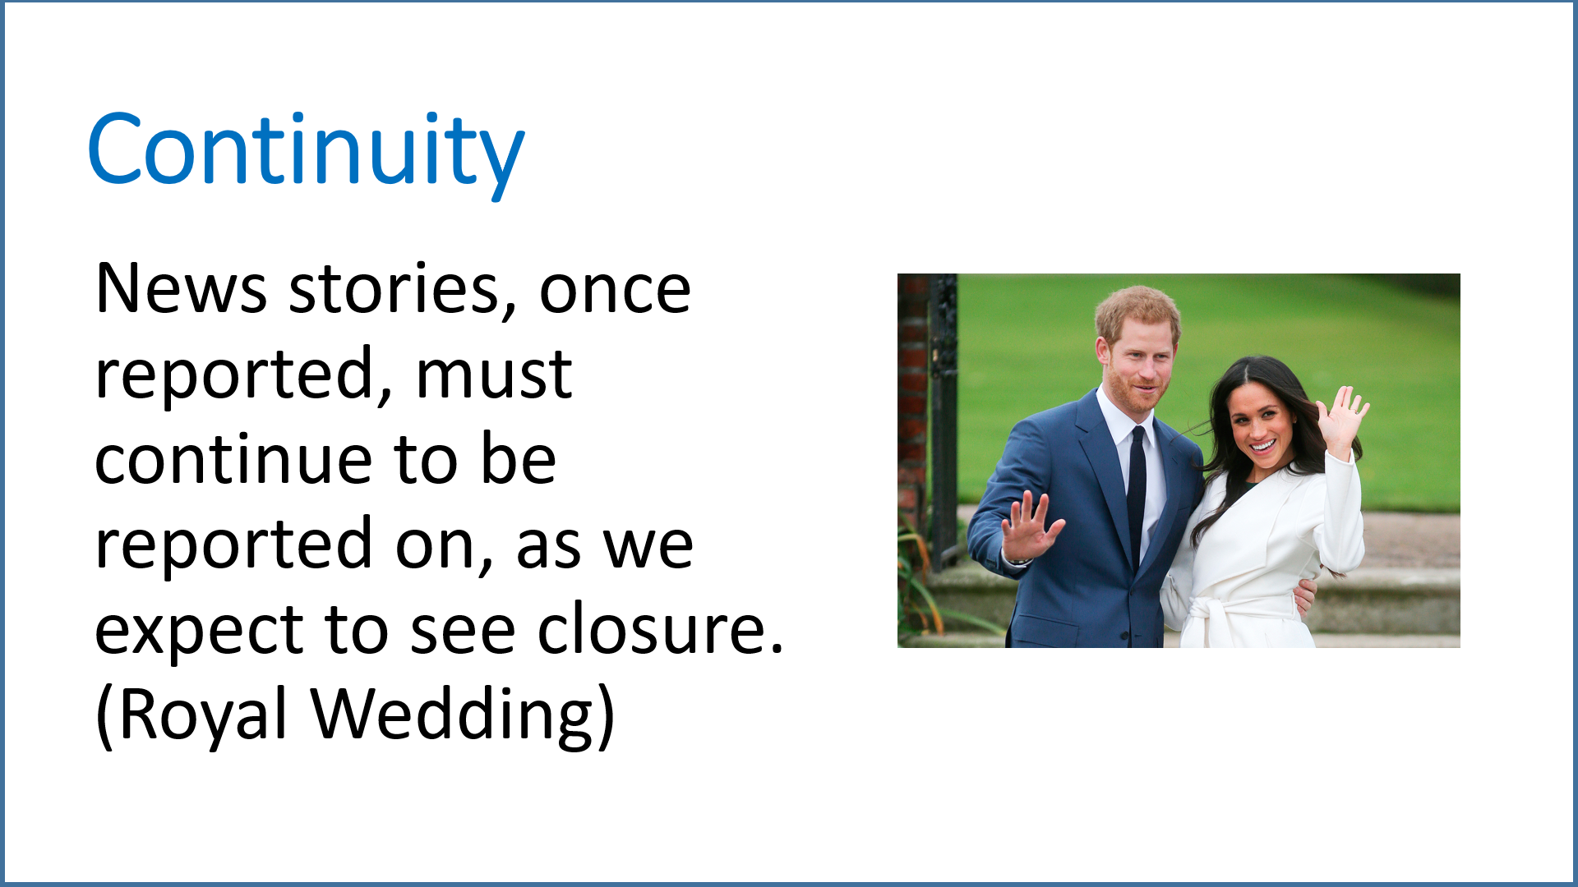
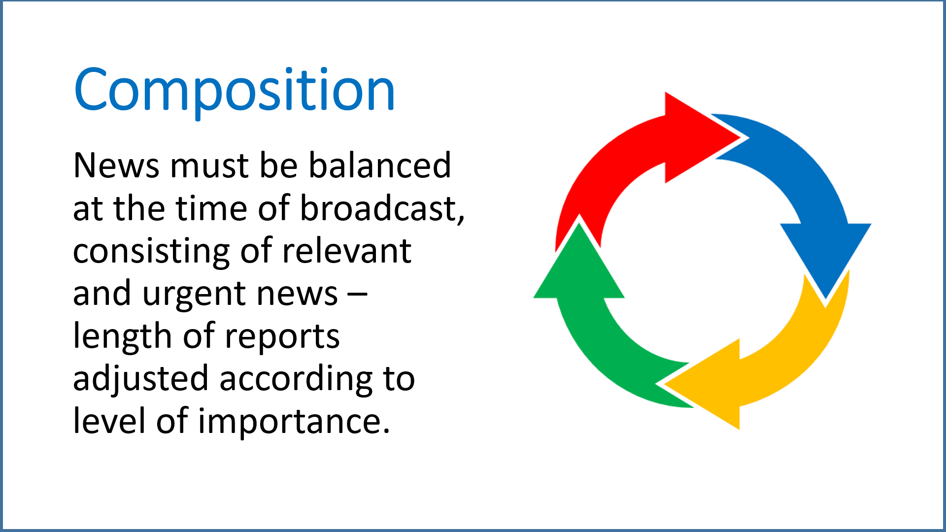

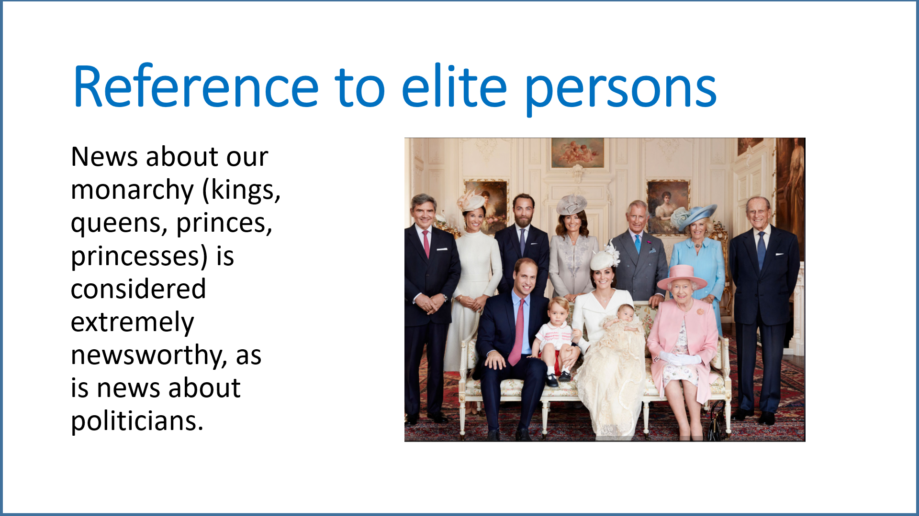
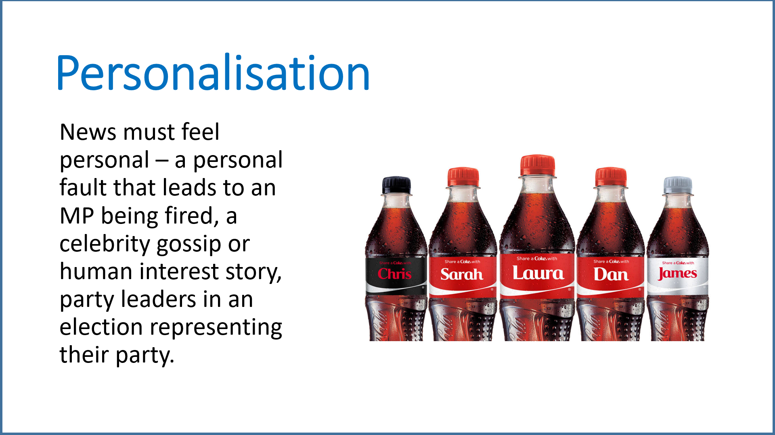
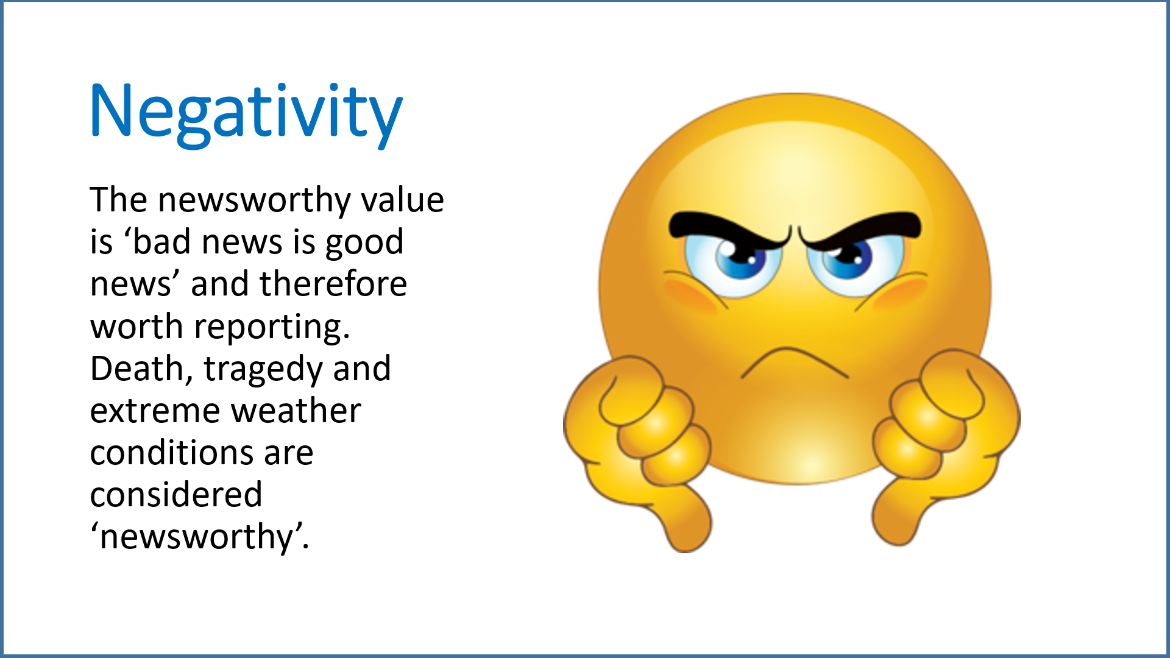


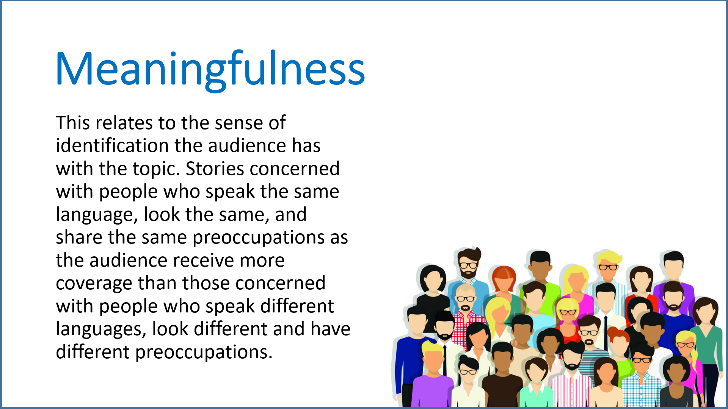
GALTUNG & RUGE’S NEWS VALUES

Slide 9
Harcup & O’Neill (2001) – News Values
Bad News
Conflict
Power of elite
Surprise
Celebrity
News agenda
Good News
Follow up
Magnitude

Slide 10
Task: Go to the BBC News website and do the following:
Group 1: Find a story that has the following news value: Meaningfulness
Group 2: Find a story that has the following news value: Conflict
Group 3: Find a story that has the following news value: Unexpectedness
Group 4: Find a story that has the following news value: Negativity
Group 5: Find a story that has the following news value: Celebrity
Group 6: Find a story that has the following news value: Proximity

Slide 11

Frequency
Events that happen frequently (i.e.often) are more likely to be covered.
Long-term trends are not likely to receive much coverage.

Slide 12
The frequency of Premiership football news on BBC News suggests that the audience considers sports news vital to their everyday life. BBC News know that this is a popular segment which must be repeated daily.

Slide 13
Step #1: Look at these two examples to see how the term frequency is applied when writing about News Values.
The frequency of reporting on immigration shows that ITV News considers this an important issue for their news agenda.
The frequency of reporting on immigration on ITV News suggests that it is considered ‘in the public interest’ and each news package on the issue stirs debate.
Now make your own sentence about Premiership football and the frequency of its broadcasting on BBC News.

Slide 14

Example answer
The frequency of Premiership football news on BBC News suggests that the audience considers sports news vital to their everyday life.
The frequency of BBC News ending a news programme with sports news shows that they know that this is a popular segment which must be repeated daily.
How did you get on?

Slide 15
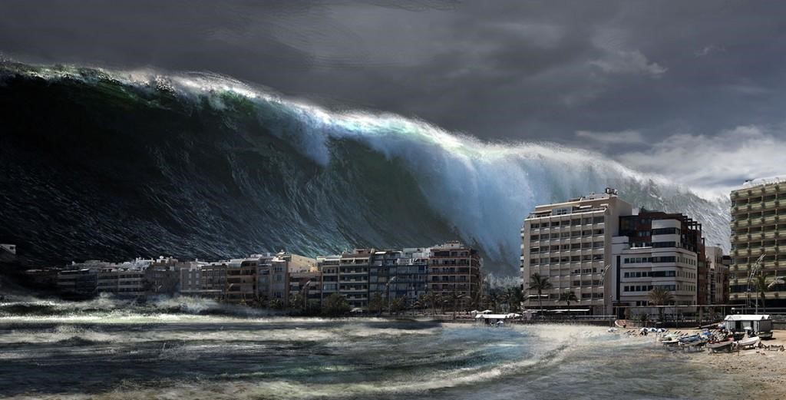
Threshold
Events that have impact – large numbers involved – murders, accidents, natural disasters – this is considered ‘newsworthy’.

Slide 16
Look at this example to see how the term threshold is applied when writing about News Values.
A crash on the M25 at Potters Bar did not make the national news because it did not meet the threshold. However, Trump’s Twitter nuclear war threat to Kim Jong-Un of North Korea made the headlines because it did meet the threshold.
Which of the following stories would meet the threshold for national headline news?
Acid attacker in nightclub jailed for 8 years.
Judges rule ‘mailbag thief’ was framed.
Brexit deal under threat
London bus drivers given pay rise.

Slide 17
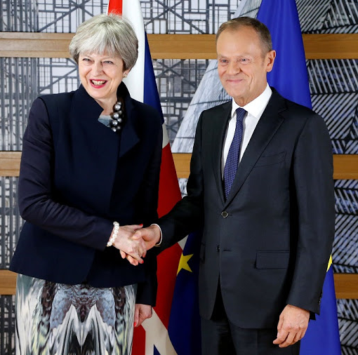
The answer
C. Brexit process triggered by Article 50.
Why?
The other answers are examples of local news which may feature in a news report but would not come before Brexit news.
Brexit Britain is due to leave the EU next Spring. The government and the British people are waiting for a deal to be signed.
This is a very controversial subject where British citizens are very divided and any major new steps lead to headline news.
It is considered way above the threshold for being ‘newsworthy’ and developments will continue to feature in the news throughout the year.

Slide 18
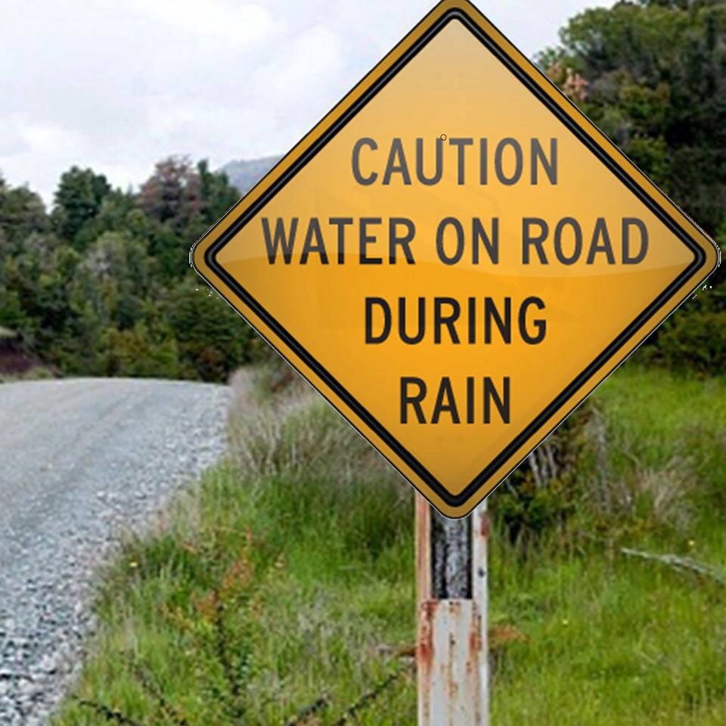
Unambiguity
News reports must have immediate meaning and no ambiguity, so they can be easily understood.

Slide 19
Look at this example to see how the term unambiguity is applied when writing about News Values.
The report on Muhammed Ali’s death in June 2016 is an example of unambiguity in news reporting. It is clear what has happened and the report can now celebrate the highlights of his life like it was a funeral eulogy.
Which of these headlines are more ambiguous than the others?
Rohingya Muslims persecuted in Myanmar.
Kim Jong-Il’s eldest son assassinated.
CIA documents released by Wikileaks.
Carillion construction faces review.

Slide 20
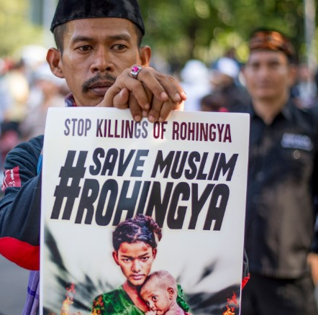
The answer: A
B, C and D have a clear message that can be easily understood. A is a more ambiguous story because there may be a difference of opinion.

Slide 21

Proximity
News must be about the people it is targeting
and be relevant to them.

Slide 22
Look at this example to see how the term proximity is applied when writing about News Values.
This ‘Fresh Snow Alert Sparks Travel Warning’ BBC News report is an example of proximity because it is news which affects many people in the country directly and is relevant to their immediate experience.
Which of these two stories is an example of proximity? Explain briefly why.
A. Koreans to march under single 'united' flag in Olympic Games.
B. NHS 'haemorrhaging' nurses as 33,000 leave each year.

Slide 23
The answer
B. NHS 'haemorrhaging' nurses as 33,000 leave each year.
Nurses leaving the NHS will have a direct impact on the waiting lists and quality of service in UK hospitals which will affect many UK citizens. This is relevant news with a tangible impact.

Slide 24

Predictability
News that is expected and then becomes real as expected by the media.

Slide 25
Step #5: Look at this example to see how the term predictability is applied when writing about News Values.
Channel 4 News reports reference Trump’s Twitter account saying “Donald Trump continues to believe there is widespread illegal voting in the USA.” There is predictability that Trump will say offensive things on social media and will have future reports on the matter. It is unlikely that this will be the last report on Trump’s Twitter and Channel 4 News is aware of this.
Why are these headlines all examples of predictability?
Jose Mourinho is at risk of being fired by Man U FC but is still hanging on.
The effects of global warming continue with increasing volatility in weather patterns.
Brexit process will lead to more division.

Slide 26
The answer
All of these headlines feature inevitable events. Mourinho’s future as Manchester United manager has been questioned for a while, global warming is not a myth and Brexit has always been a divisive subject. Some news will always have a level of predictability and will be repeated in broadcasts.

Slide 27

Unexpectedness
Events that are unexpected are considered newsworthy. For example, ‘Man eaten by tiger’.

Slide 28
Look at this example to see how the term unexpectedness is applied when writing about News Values.
On the BBC News website in 2013, more people clicked on the unexpectedness of a horse trotting into a McDonald’s rather than Kate Middleton giving birth to a baby boy. This is because unusual stories have appeal due to their novelty. These are examples of soft news ‘clickbait’ stories used to lighten the hard-hitting tone of most news programmes.
Invent a headline which uses unexpectedness as a ‘news value’ technique.

Slide 29
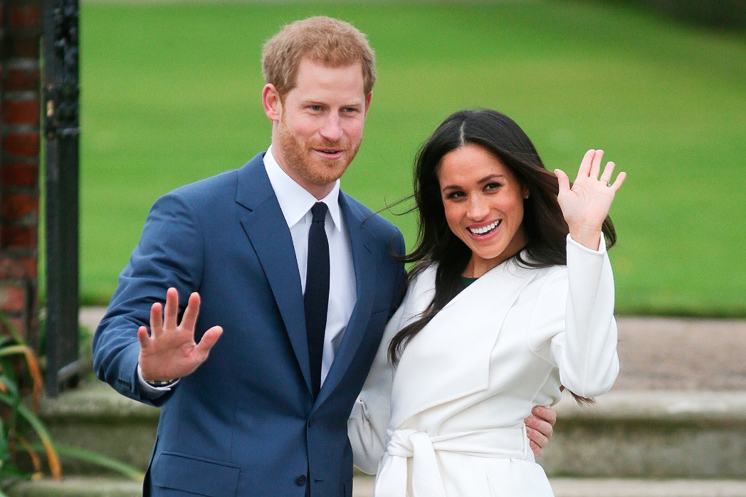
Continuity
News stories, once reported, must continue to be reported on, as we expect to see closure.
(Royal Wedding)

Slide 30
Step #7: Look at this example to see how the term continuity is applied when writing about News Values.
On ITV News, the Stock Exchange developments, Sports results and Royal Family updates are an example of continuity in news. Repeat coverage will need to take place and stages of development will be tracked to check on progress.
Which of the following are examples of continuity in News Values? Why?
Harry and Meghan’s relationship.
Newcastle’s football season.
Google, Apple and Amazon shares on the FTSE 100.

Slide 31
The answer
All of them! Multiple reports on all of these news topics can take place over time creating a sense of continuity.

Slide 32

Composition
News editors prefer to provide their audience with good balanced mix of news stories e.g. some serious news, some lighter news, some sport,

Slide 33
Step #8: Look at this example to see how the term composition is applied when writing about News Values.
On BBC News, Prime Minister’s Questions features Theresa May (Conservative PM) and Jeremy Corbyn (Labour Leader) debating key issues in parliament.
The composition of the news package ensures that both are given equal air time.
Which news channels listed have a bad reputation for extreme bias when it comes to the composition of their news packages?
Fox News
BBC News
ITV News
Channel 4 News
Al-Jazeera News

Slide 34
The answer
A. Fox News
Fox News is known for one-sided propaganda, which is a form of imbalanced composition. It is known for racism and Islamophobia, with a strong bias against Black people, immigration, LGBT rights, and has aggressively capitalist and conservative values that is pedalled through news packages and ‘debates’.
Take note: arguably, this presentation of Fox News’ values is also an example of imbalanced composition!

Slide 35

Reference to Elite Nations
News which relates culturally to our own and which is relevant to us. We are not necessarily interested in the news of a tiny country we have never heard of on the other side of the world, but we are interested in European news because it is close to us.

Slide 36
Step #9: Look at this example to see how the term reference to elite nations is applied when writing about News Values.
On UK news channels, news in Third World and Developing countries are not as valued as any reference to elite nations such as UK, USA, Australia and European countries. When a non-elite nation is referenced, it is usually because the nation in question is seen as a threat to elite nations.
Which of these headlines is not a reference to elite nations?
Seven dead in mass killing at Kenyan boarding school.
France elect Emmanuel Macron as their new President.
Civil unrest in Spain is growing over Catalan protests for independence.

Slide 37
The answer
Seven dead in mass killing at Kenyan boarding school.
Despite this being a shocking story and an important news item that should be a headline, it may be ignored or pushed down the list of news stories because it is not a reference to an elite nation like ones about France and Spain.

Slide 38
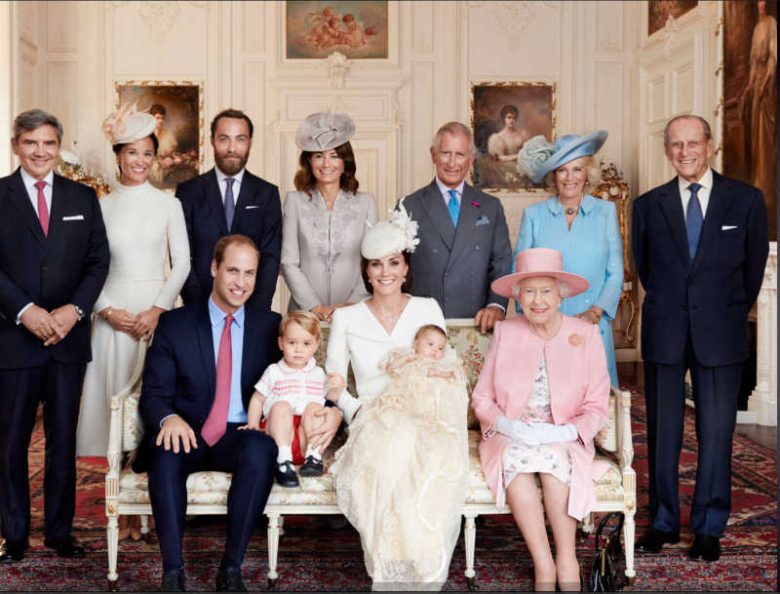
Reference to elite persons
News about our monarchy (kings, queens, princes, princesses) is considered extremely newsworthy, as is news about politicians.

Slide 39
Look at this example to see how the term reference to elite persons is applied when writing about News Values.
Imaginary example:
On Sky News, reference to elite persons rolling coverage of the Royal Family wedding takes place with live interviews of fans of the monarchy and distant relatives who may have titbits of information about Prince Harry and Meghan Markle. Despite an attack taking place in Hull, this only features as a brief news bulletin before heading straight back to the Royal Wedding.
Task – penboard
Which of these headlines is not a reference to elite persons?
Oprah Winfrey gives speech at Golden Globes after winning Cecil B. DeMille Lifetime Achievement Award.
Nikki Edwards, Tesco People Manager starts a social action initiative in Glamorgan.

Slide 40
The answer
B. Nikki Edwards, Tesco People Manager starts a social action initiative in Glamorgan.
Nikki Edwards (Tesco People Manager in Glamorgan) is not a reference to an elite person like Oprah Winfrey, so this story is unlikely to become headline news.

Slide 41
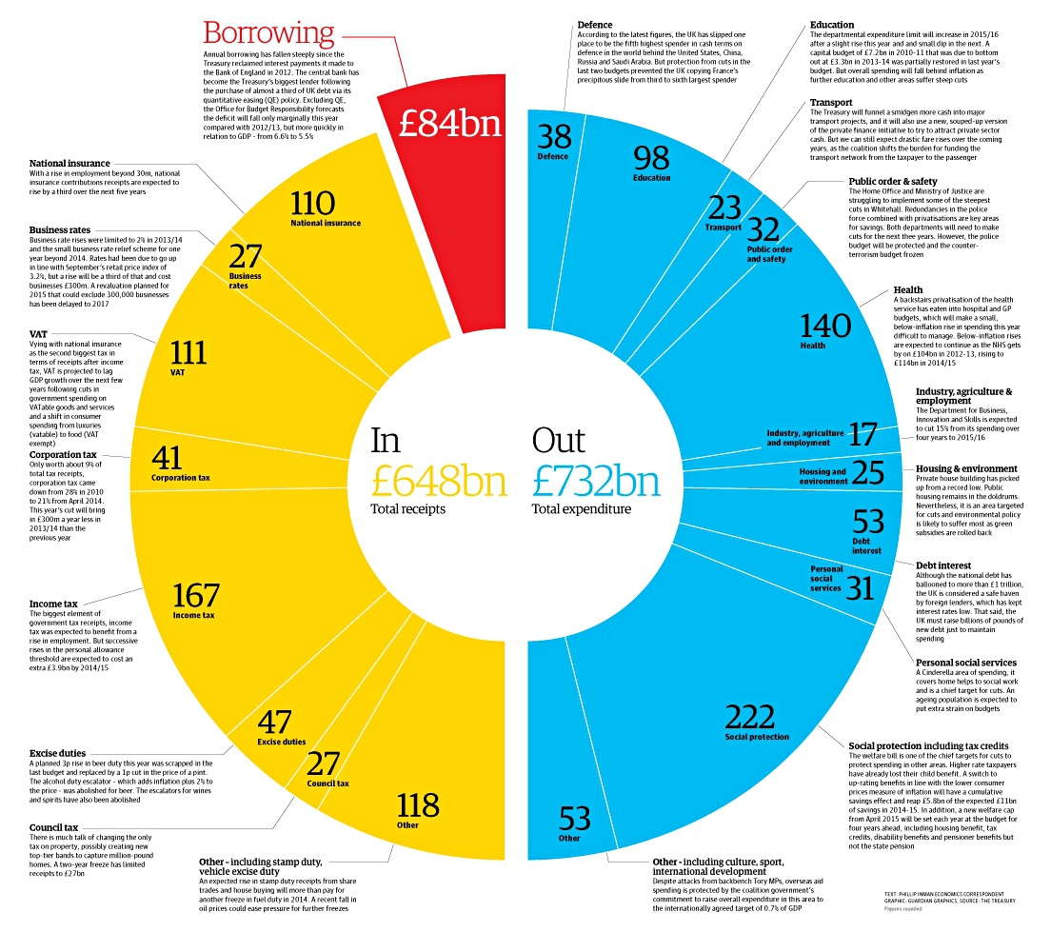

The news values the UK government Budget
Incoming money - £648bn
Outgoing money - £723bn

Slide 42
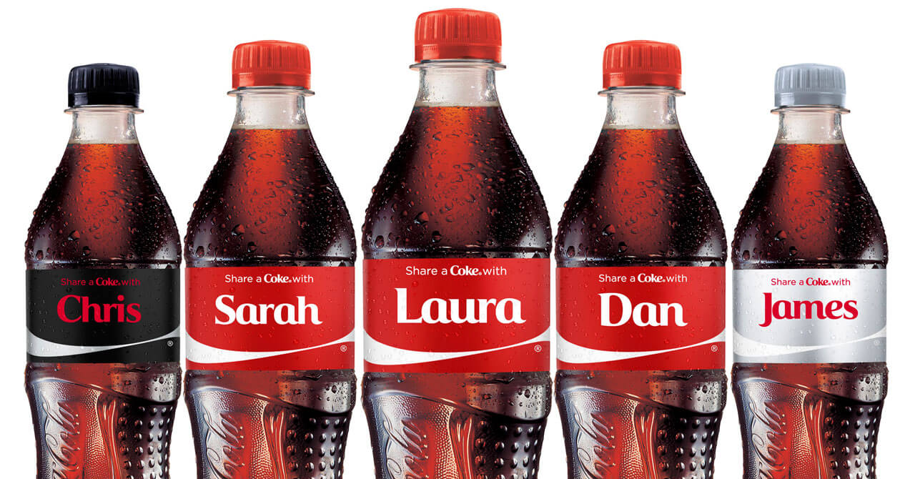
Personalisation
News stories which can be made personal, i.e. can be made to be about an individual, is considered newsworthy.

Slide 43
Look at this example to see how the term personalisation is applied when writing about News Values.
Which of these headlines is not a personalisation?
Harvey Weinstein has been accused of sexual assault, harassment or rape by 84 different women.
Angelina Jolie reveals why she split up with Brad Pitt.
News Corp accused of colluding with Northern Territory government.

Slide 44
The answer
C. News Corp accused of colluding with Northern Territory government.
Even though News Corp is owned by Rupert Murdoch, a corporation is not a person (no matter what certain corporate owners would have you believe!). It is the only headline not personalised here.

Slide 45

Negativity
The newsworthy value is ‘bad news is good news’ and therefore worth reporting. Death, tragedy and extreme weather conditions are considered ‘newsworthy’.

Slide 46
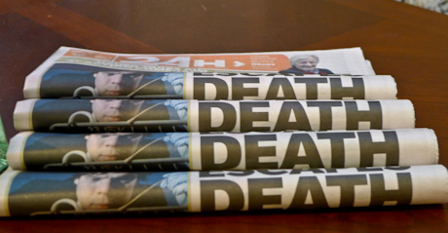
Look at this example to see how the term negativity is applied when writing about News Values.
News programmes thrive on negativity and bad news. This one is self-explanatory.
Write one word which you think is the most commonly used negative word in TV News broadcasts.

Slide 47
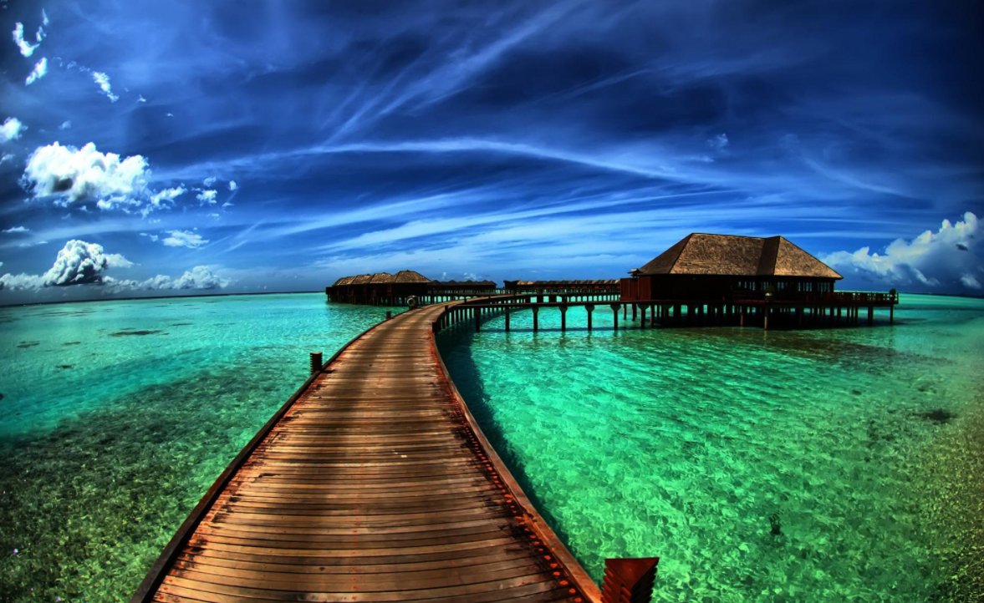
Visual imperative
Footage or photos of an event can help make a story more newsworthy.

Slide 48
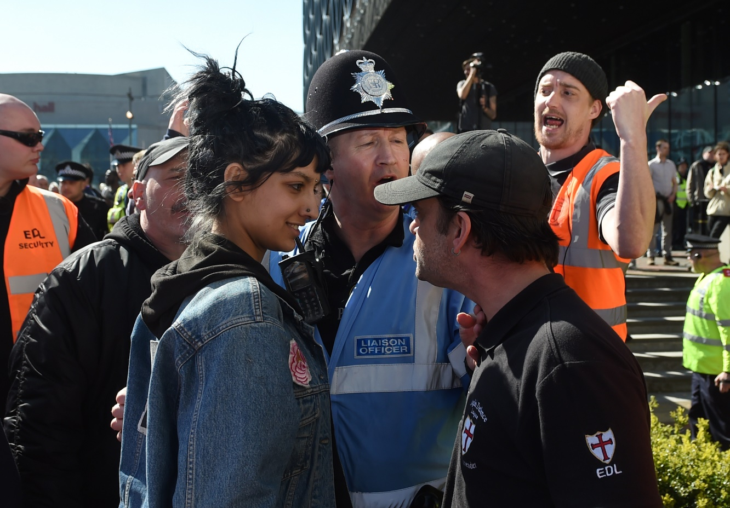
Look at this example to see how the term visual imperative is applied when writing about News Values.
The Guardian highlighted the visual imperative of a British muslim woman peacefully standing up to an EDL protester. Its iconic quality has made the story go viral.

Slide 49

Consonance
Stories that fit with the media's expectations receive more coverage than those that defy them. Consonance refers to the media's readiness to report an item, usually one which fits with their own values.

Slide 50
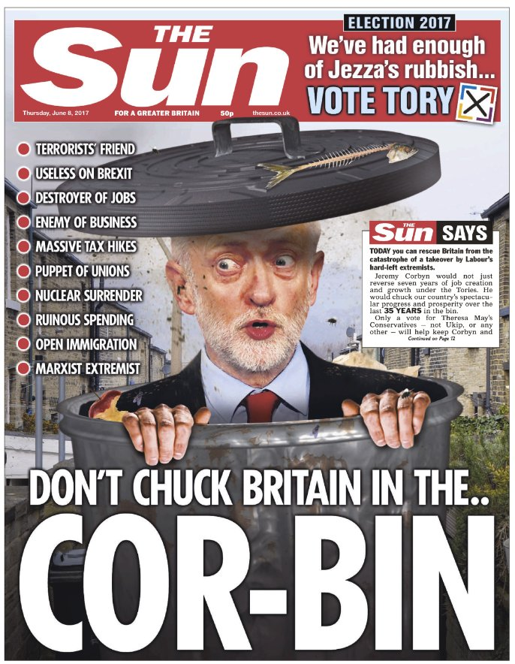
Look at this example to see how the term consonance is applied when writing about News Values.
Newspapers and TV News broadcasters that support the Conservatives and strongly disagree with socialism and Corbyn as Labour leader will use consonance by only accepting stories which fit their narrative. If someone wrote a passionate pro-socialism piece as a Sun columnist, they would probably be fired!

Slide 51

Meaningfulness
Stories that the target audience can relate to are considered more newsworthy.
Stories concerned with people who speak the same language, look the same, and share the same preoccupations as the audience receive more coverage than those concerned with people who speak different languages, look different and have different preoccupations.

Slide 52
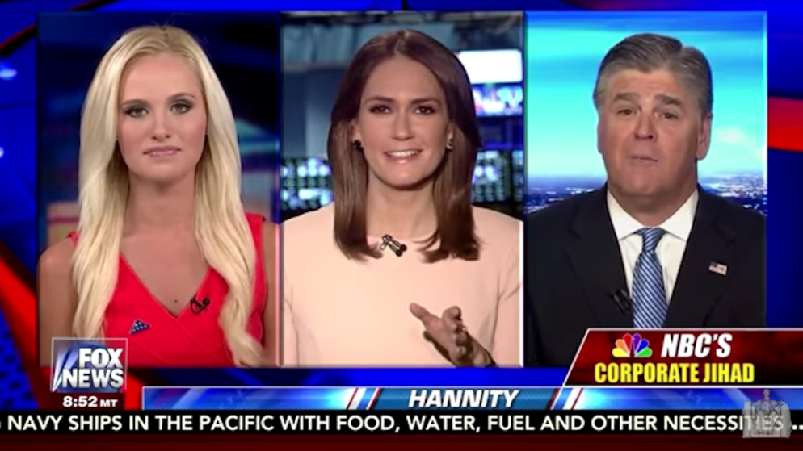
Look at this example to see how the term meaningfulness is applied when writing about News Values.
TV News broadcasters will share stories featuring speakers who share the same values as the audience and the broadcasters themselves, an example of meaningfulness.
Fox News will share their platform with those they agree with and they will sideline or criticise those they disagree with.

Slide 53
Additional Terms [ADVANCED]
Conflict: Opposition of people or forces resulting in a dramatic effect. Stories with conflict are often quite newsworthy.
Competition: Commercial or professional competition between media may lead journalists to endorse the news value given to a story by a rival.
Co-optation: A story that is only marginally newsworthy in its own right may be covered if it is related to a major running story.
Prefabrication: A story that is marginal in news terms but written and available may be selected ahead of a much more newsworthy story that must be researched and written from the ground up.
Time constraints: Traditional news media such as radio, television and daily newspapers have strict deadlines and a short production cycle, which selects for items that can be researched and covered quickly.
Logistics: Although eased by the availability of global communications even from remote regions, the ability to deploy and control production and reporting staff, and functionality of technical resources can determine whether a story is covered. (Schlesinger, 1987)
Data: Media need to back up all of their stories with data in order to remain relevant and reliable. Reporters prefer to look at raw data in order to be able to take an unbiased perspective.

Slide 54
News Value | Definition
Frequency | Events that occur suddenly and fit well with the TV News schedule are more likely to be reported than those that occur gradually or at inconvenient times of day or night. Long-term trends are not likely to receive much coverage.
Threshold | Events that have impact – large numbers involved – murders, accidents, natural disasters – this is considered ‘newsworthy’.
Unambiguity | News reports must have immediate meaning and no ambiguity, so they can be easily understood.
Proximity | News must be about the people it is targeted at and be relevant to them.
Predictability | News that is hinted at and then becomes real as expected by the media.
Unexpectedness | Events that are unexpected are considered newsworthy. For example, ‘Man eats tiger’.
Continuity | News stories, once reported, must continue to be reported on, as we expect to see closure. (Royal Wedding)
Composition | News must be balanced at the time of broadcast, consisting of relevant and urgent news – length of reports adjusted according to level of importance.
Reference to elite nations | News which relates culturally to our own and which is relevant to us. We are not necessarily interested in the news of a tiny country we have never heard of on the other side of the world, but we are interested in European news because it is close to us.
Reference to elite persons | News about our monarchy (kings, queens, princes, princesses) is considered extremely newsworthy, as is news about politicians.
Personalisation | News must feel personal – a personal fault that leads to an MP being fired, celebrity gossip or a human interest story, party leaders in an election representing their party.
Negativity | The newsworthy value is ‘bad news is good news’ and therefore worth reporting. Death, tragedy and extreme weather conditions are considered ‘newsworthy’.
Visual imperative | Footage or photos of an event can help make a story more newsworthy.
Consonance | Stories that fit with the media's expectations receive more coverage than those that defy them. Consonance refers to the media's readiness to report an item, usually one which fits with their own values.
Meaningfulness | This relates to the sense of identification the audience has with the topic. Stories concerned with people who speak the same language, look the same, and share the same preoccupations as the audience receive more coverage than those concerned with people who speak different languages, look different and have different preoccupations.

Slide 55
Plenary
Kahoot! Quiz on News Values terms.
Check today’s objective – LO: to understand how to apply news values terms.
On your post-it note write 2 things you learnt in today’s lesson.
Then on the back write one thing you need more help with or would like to spend more time on to secure your understanding.
How did you get on?

Slide 56
TASK: BLOG POST –NEWS VALUES (4.1.1, 4.1.2, 4.1.3, 4.2.1, 4.2.2)
Deadline: Friday 16th Nov 2018
Explain the term News Values.
Select one of the following:
The Sheffield Star website
The Vibe website
The BBC News website
The Daily Mail website
The Guardian website
Find examples of at least three of Galtung and Ruge’s (1965) News Values.
3. Compare and contrast Galtung and Ruge’s theory with Harcup & O’Neill’s (2001) theory.

Slide 57
What different representations exist in TV News today?
PSB vs Commercial
Audiences
Hard News vs Soft News
BBC NEWS
ITV NEWS
DEMOGRAPHICS
POLITICS
CELEBRITY
SKY NEWS
MODE OF ADDRESS
ECONOMICS
SPORT
CHANNEL 4 NEWS
ORGANISATION – AUDIENCE POSITIONING
News Values
Representation
Ideology
‘NEWS-WORTHINESS’
Bias
IN THE PUBLIC INTEREST
LEFT WING - SOCIALIST
CENTRIST - LIBERAL
Regional
National
Rolling
Specialist
SOUTH EAST TODAY
Format and structure
RIGHT WING - CONSERVATIVE
BBC NEWS
Conventions
Shot types
ESTABLISHING SHOT
BBC NEWS 24
MOVING – PAN, TRACK
STUDIO SET
PIECE TO CAMERA
VOX POPS
LONG SHOT
HIGH ANGLE
EUROSPORT
OUTSIDE BROADCAST
VOX POPS
VOICEOVER
MEDIUM SHOT
LOW ANGLE
CLOSE UP
EYE LEVEL

Slide 58
News Types – Local/Regional, National, Global, Rolling, Specialist
Local/Regional | National | Global | Rolling | Specialist
This type of news has a local context and is not of interest to anyone who does not live within that locality. Examples of regional news broadcasts: BBC Look East, BBC London News. | This type of news focuses on immediate global news with the main focus on reporting news from the United Kingdom. Examples are BBC News, ITN News, Sky News, Channel 4 News, 5News. | This type of news focuses on immediate global news. However, there is a focus on news reports from all over the world. Examples are BBC World News, Sky News International. | This type of news emphasises live and breaking news with a ticker. It is often 24/7 news and recycles news every 30 minutes. Examples are BBC News 24, Sky Sports News. | This type of news focuses on a certain sub-category of news. Examples are Eurosport, Daybreak.

Slide 59
Hard News vs Soft News
Hard News | Soft News
This type of news is ‘up-to-the-minute’ news and events that are reported immediately after they have taken place. Subject matter may be economics, politics, war and crime. It refers to news, which is usually very serious, perhaps urgent. Factual and formal tone of presentation. | This type of news is intended to entertain or inform the reader and refers to stories that are usually of human interest. Subject material may be celebrity gossip, fashion tips, technology, and humorous and feel -good stories. It is not time sensitive.Informal tone of presentation.

Slide 60
Broadcasting
Public Service Broadcasting
The Beginning
John Reith’s Four Principles
The heart of the BBC
There are 2 forms of broadcasting in the UK:
- Public Service Broadcasting (PSB)
– e.g. BBC
- Private/ commercial Broadcasting
– e.g. BSKYB
1922 the British Broadcasting Company (later to become Corporation) was founded and led by the BBC’s first Director General, John Reith.
The BBC followed his view that broadcasting should be organised in the public interest.
BBC Founded in 1922 by Director General, John Reith
Broadcasting should be protected from commercial pressures and the profit motive.
Broadcasting should provide services to the whole community, and should be national.
Broadcasting should be characterised by ‘unified control’ (a strong monopoly).
Broadcasting must be closely regulated to establish high standards and ensure that programmes are of
a high quality.
INFORM
EDUCATE
ENTERTAIN
A Big Criticism
Although some see Reith as having good intentions his views were often criticised.
In 1924 Reith was quoted to say:
‘It is occasionally indicated to us that we are apparently setting out to give the public what we think they need – and not what they want, but few know what they want, and very few what they need’

Slide 61
Finding a Balance
ITV
Channel 4
Channel 4 Remit
Along came Sky
To break the BBC’s monopoly in 1954 ITV was founded.
This is a commercial channel funded by advertising.
Reith feared that advertisers would influence programme content as in the US.
However, in the UK terrestrial broadcasting regulation insists that broadcasting should primarily benefit the public.
Now established ITV provided an alternative for the public.
However, it was mainly concerned with the commercial viability of its products and the maximum profit it can create.
Then something interesting happened as ITV was accused of having a monopoly over the sale of advertising space.
To break the advertising monopoly of ITV and provide something alternative to the BBC, Channel 4 was created in 1982.
Channel 4 is also a Public Service Broadcaster, even though it is funded through advertising.
It has remit of public service obligations it must fulfil to continue to broadcast.
If it does not comply to these rules theoretically it can legally be shut down.
Demonstrate innovation, experimentation and creativity in the form and content of its programmes.
Appeal to the tastes and interests of a culturally diverse society.
Make a significant contribution to meeting the needs for the licensed public service channels to include programmes of an educational nature and other programmes of educative value.
Exhibit a distinctive character.
Finally in 1998 Sky Television is launched (BSKYB owned by News Corp).
This was the first satellite and subscription service in the UK and took on the US style of broadcasting.
This is commercial broadcasting in its finest form as it has no remit to fulfil and is profit lead.
Provides a huge variety of channels and programmes to its audience for a fee.
Which is better: Public Service Broadcasting or Commercial?

Slide 62
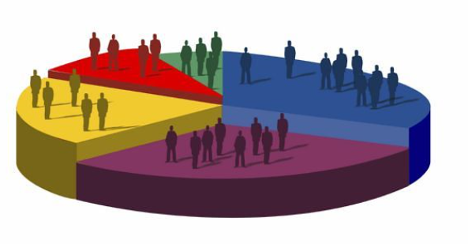
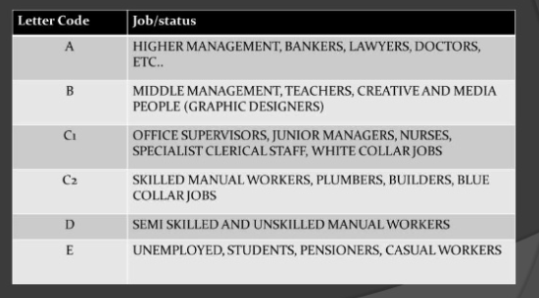
Demographics – audiences can be categorised. Programmes seek target audiences.
Age
Occupation
Location
Upbringing
Class
Race
Gender
Sexuality
Culture
Ideology (values)
Interests
Advanced:
Psychographics
Young and
Rubicam’s Consumers:
Mainstreamers
Aspirers
Succeeders
Resigned
Explorers
Strugglers
Reformers

Slide 63
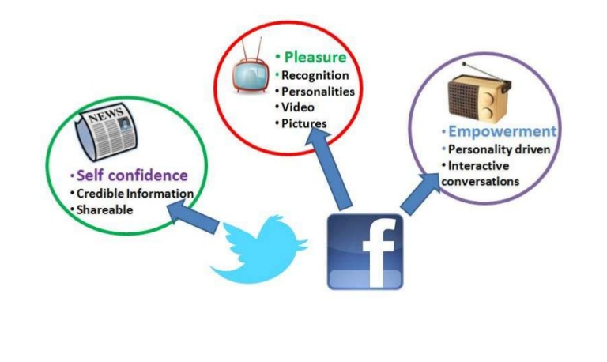
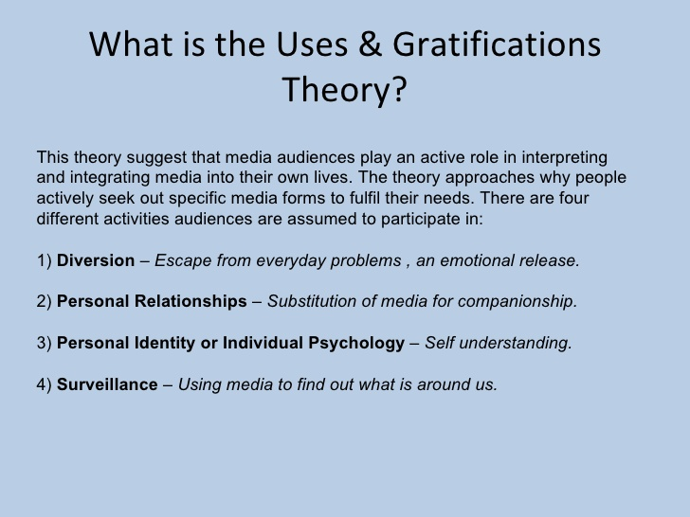
Uses and Gratifications Theory – appealing to the audience’s needs

Slide 64

Conventions of a News Programme
Studio News Readers – professional, smart, respectable, direct address reporting.
Correspondents – on-location presenters responsible for specific reports (live/recorded).
Experts – interviewed on a specialist topic, looking at interviewee not camera.
The studio set – table, desk, seats, sofa, graphics screens.
The studio background – graphics or busy newsroom to stress urgency of news.
Crew members – camera operators, researchers, copywriters, script writers, operators
Witnesses/General Public (vox pops) – montage/soundbites of on-location interviews.
Typical features of a News Programme
- Establishing shot – setting the scene (giving a long-shot of the location – interior or exterior).
- News package – single news feature linked to from TV studio (pre-recorded/edited).
- Outside broadcast (OB) – live feed to a reporter at the location of the news story/event.
- Piece to camera (PTC) – reporter addresses the audience straight down the camera.
- General Views (GVs) – shots to illustrate a story (visuals important in TV).
- Voiceover (VO) – Reporter’s voice tells the audience the story and facts with GVs as a wallpaper.
- Interviews – Interviews with contributors (key people, witnesses, experts) on story.
- Vox-pops – Short interviews canvassing the opinion of the public (voice of the people).
- News crawl/ticker – across the lower part of the screen with top stories and breaking news.
- Title sequence/graphics montage – introduces the show with dramatic style.
- Captions/intertitles – signposts names of presenters, interviewers, correspondents and interviewees.
- Non-diagetic pulsing music – used as a background to the rundown of top stories/headline introduction.
- Rolling news schedule – structure of most to least important news story (“and finally”).
- Archive footage – sometimes used in a feature report to give contrast between ‘then’ and ‘now’.
- Ident – logo of the news programme.
- Human interest story – feature story that discusses a person, or people, or a pet in an emotional way.
Example: Mise-en-scene of the start of a news programme
- Medium close-up of the presenter giving a direct address to the audience, wearing smart, conservative clothes and with a serious expression and minimal body language. The camera will zoom in on still images during stories for dramatic effect.
Industry
Broadcast Media
Who owns and runs it?
James Harding (Director of News & Current Affairs) – 3,500 employees with an annual budget of £89.5 million (and an extra £23.1 million for its rolling news channel).
PSB or Commercial?
Public Service Broadcasting.
What are their viewing figures?
4.8 million viewers per week.
Messages and values?
INFORM, EDUCATE, ENTERTAIN.
History and style.
- BBC Founded in 1922 by Director General, John Reith.
Four Broadcasting Principles.
1. Protected from commercial pressures and the profit motive.
2. Provide services to the whole community, and should be national.
3. Characterised by ‘unified control’ (a strong monopoly).
4. Closely regulated to establish high standards and ensure that programmes are of a high quality.

Slide 65
How does the programme (BBC News at 10 – Sunday 26th November 2017) apply conventions of a TV News show in order to present the news?
The medium close up direct address shot of a female anchor in a green suit saying “The growing divide between the UK and the Irish republic…” shows that this is serious headline news regarding Brexit. The non-diagetic drumbeat gives the impression of a new story and the whole news package is summarised within a matter of seconds. The effect on the spectator is to prepare for a formal presentation of public service news broadcasting. Her serious tone in introducing the news package conveys the importance of this headline news.
The presenter introduces a second report which is punctuated by another non-diagetic drumbeat. The report moves from the studio back to another news package. An establishing shot of a street with police vans cordoning off a road is given, as a report of joyriders who accidentally kill pedestrians by knocking over a tree is given. A voice over from the studio is given to announce this. This outside broadcast identifies how a local tragic story has national significance. Whilst the Brexit report was considered the most important, this shocking story was considered the second most important headline that day with the rolling news coverage with general views of the scenario. The effect on the spectator is how possible something this horrible could be. The streets seem like a typical town. It reveals the ideology of the news report: to rebuke illegal activity in suburban areas with an authoritative tone.
Another drumbeat announces a third report with a cut to a zoomed in close up of a photograph of an Iranian couple which challenges the state TV propaganda to villainise them. A general view of this photograph is used because they do not have filmed coverage of the couple in question. The zooming in heightens the dramatic tension surrounding the report. The continuing non-diagetic background music reinforces this. The effect on the spectator is to identify how the news report seeks to inform about key social and political events that would be considered ‘in the public interest’.
The fourth report features a general view of “a special report from Lake Victoria” with a slow-motion shot of a man at sunset throwing a fishing net into the lake. There is diagetic music where locals play on drums. It cuts to an establishing shot of a lake, which the presenter reports, “is slowly dying”. This outside broadcast illustrates the danger of global warming and the effect of a ravaged landscape due to a poor maintenance of the environment. The fact that this is highlighted as a ‘special report’ from other news correspondents suggests that it has extra significance and importance. This report has an environmental ideological agenda which seeks to raise awareness towards stewardship of our environment. It shows that the news station (specifically with this report) has a bias towards left-leaning agendas.
The final headline begins with the rolling coverage convention “and finally” to give a general view report of an Ashes cricket match which England lost to Australia. The voiceover report from the anchor asks the rhetorical question: “are England heading for defeat?” The news programme theme tune and introductory title sequence and graphics montage follow. This outside broadcast features highlights from the cricket match and is a light-hearted counterpoint to the severe headlines that feature throughout the rest of the news report. This acts as a book-end to the headline news briefing. The producer's intent is to soften the effect of hard-hitting news reports on the spectator by showing that 'it is not all doom and gloom'. The ideology of the show is represent balance and impartiality, whilst attempting to educate, inform and entertain. This last report is intended to entertain.

Slide 66
How does the programme (BBC News at 10 – Sunday 26th November 2017) apply conventions of a TV News show in order to present the news?
Denotation | Connotation | Effect
The medium close up direct address shot of a female anchor in a green suit saying “The growing divide between the UK and the Irish republic…” | …shows that this is serious headline news regarding Brexit. The non-diagetic drumbeat gives the impression of a new story and the whole news package is summarised within a matter of seconds. | The effect on the spectator is to prepare for a formal presentation of public service news broadcasting. Her serious tone in introducing the news package conveys the importance of this headline news.
The presenter introduces a second report which is punctuated by another non-diagetic drumbeat. The report moves from the studio back to another news package. An establishing shot of a street with police vans cordoning off a road is given, as a report of joyriders who accidentally kill pedestrians by knocking over a tree is given. A voice over from the studio is given to announce this. | This outside broadcast identifies how a local tragic story has national significance. Whilst the Brexit report was considered the most important, this shocking story was considered the second most important headline that day with the rolling news coverage with general views of the scenario. | The effect on the spectator is how possible something this horrible could be. The streets seem like a typical town. It reveals the ideology of the news report: to rebuke illegal activity in suburban areas with an authoritative tone.
Another drumbeat announces a third report with a cut to a zoomed in close up of a photograph of an Iranian couple which challenges the state TV propaganda to villainise them. | A general view of this photograph is used because they do not have filmed coverage of the couple in question. The zooming in heightens the dramatic tension surrounding the report. The continuing non-diagetic background music reinforces this. | The effect on the spectator is to identify how the news report seeks to inform about key social and political events that would be considered ‘in the public interest’.
The fourth report features a general view of “a special report from Lake Victoria” with a slow-motion shot of a man at sunset throwing a fishing net into the lake. There is diagetic music where locals play on drums. It cuts to an establishing shot of a lake, which the presenter reports, “is slowly dying”. | This outside broadcast illustrates the danger of global warming and the effect of a ravaged landscape due to a poor maintenance of the environment. The fact that this is highlighted as a ‘special report’ from other news correspondents suggests that it has extra significance and importance. | This report has an environmental ideological agenda which seeks to raise awareness towards stewardship of our environment. It shows that the news station (specifically with this report) has a bias towards left-leaning agendas.
The final headline begins with the rolling coverage convention “and finally” to give a general view report of an Ashes cricket match which England lost to Australia. The voiceover report from the anchor asks the rhetorical question: “are England heading for defeat?” The news programme theme tune and introductory title sequence and graphics montage follow. | This outside broadcast features highlights from the cricket match and is a light-hearted counterpoint to the severe headlines that feature throughout the rest of the news report. This acts as a book-end to the headline news briefing.. | The producer's intent is to soften the effect of hard-hitting news reports on the spectator by showing that 'it is not all doom and gloom'. The ideology of the show is represent balance and impartiality, whilst attempting to educate, inform and entertain. This last report is intended to entertain

